Slide 1
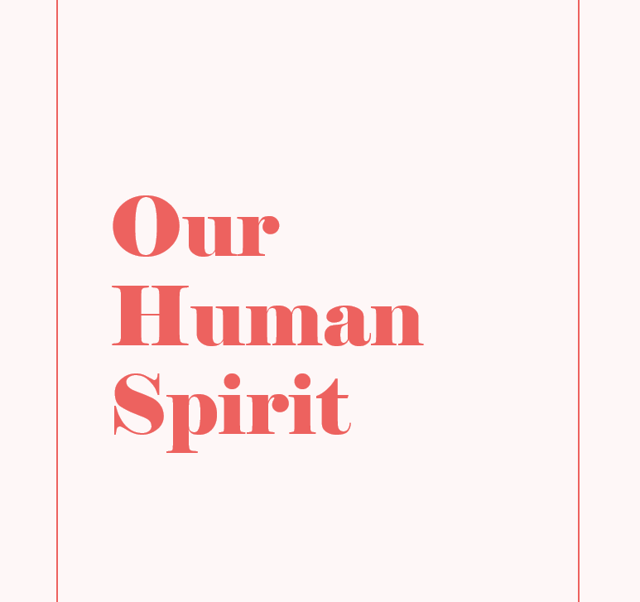
The Lamp of the Lord
The spirit of man is the lamp of Jehovah,/ Searching all the innermost parts of the inner being. – Proverbs 20:27
Mingling
Burning
Buying

Slide 2
Mingling
The spirit of man is the lamp of Jehovah,/ Searching all the innermost parts of the inner being. – Proverbs 20:27
Man’s spirit is God’s lamp within man.
The light shining within man’s regenerated spirit is God Himself.
God is light and in Him is no darkness at all. – 1 John 1:5b
Just as a lamp contains light and expresses it, man’s spirit was created to contain God and express Him.
How does an antique lamp shine?
The Spirit of God is like the oil that you add to an antique lamp as fuel.
Our human spirit is like the wick of that lamp.
For the lamp to shine, the oil needs to soak the wick.
The Spirit Himself witnesses with our spirit that we are children of God – Romans 8:16
From our spirit as the lamp, comes the light that shines into all the other parts of our inward being.
In order for the divine light to shine into man’s inward parts, God’s Spirit as the oil must soak (mingle with) man’s spirit as the wick and “burn” together with man’s spirit.

Slide 3
Burning
Do not be slothful in zeal, but be burning in spirit, serving the Lord – Romans 12:11
Very often we present our bodies and have some renewing and transformation in our mind, but our spirit is very cold, not burning. We do not pray, read the Bible, preach the gospel, or take care of people. It seems as if we do not want to do anything. This is abnormal. A normal Christian should possess three things: a presented body, a renewed and transformed mind, and a burning spirit (Romans 12:1-2, 11).
If we are not burning in our spirit, we will not pray or open our mouths when we come to the meeting. In the end we will let the “shepherds” among us pray and speak for everyone. However, if we all are burning in spirit, then when you pray, I will also pray. Everyone will function, not wanting to be left behind, and the meeting will be sweet and rich. (Being Up to Date for the Rebuilding of the Temple, Chapter 3)
Romans 12:11 says we need to be “burning in spirit.” We need to be on fire. This means that first we are burned and then we burn others. We need to be on fire in our spirit. We are burned with the burning Spirit (Rev. 4:5), and then we burn others. Oh, to be fervent! To be burning! To be on fire! Then we serve the Lord. (Our Human Spirit, Chapter 5)

Slide 4
Buying
In the parable of watchfulness in Matthew 25:8-9 Jesus says: And the foolish said to the prudent,…
…Give us some of your oil, for our lamps are going out. 9 But the prudent answered, saying, Perhaps there will not be enough for us and for you; go rather to those who sell, and buy for yourselves.
Buying means paying a price
What we need is not to do many things but rather to be burning in spirit. This requires that we pray to stay in the presence of the Lord. First, we need to set our mind on the spirit, and second, we must walk according to the spirit. Third, our spirit must be burning. We need to be on fire with the Lord as the fire.
We should pray to spend more and more time in the presence of the Lord. If we pray even for half an hour a day, we will be burning. We can compare our spirit to an electric iron. If we leave the iron plugged in for half an hour, it will be burning hot. To be burning in the spirit means that we are on fire in the spirit. The Lord Himself is the consuming fire, the holy and divine fire. Therefore, we need to stay in His presence (The Divine Spirit with the Human Spirit in the Epistles, Chapter 3).

